Slide 1


K.RAMAKRISHNAN COLLEGE OF TECHNOLOGY
(AUTONOMOUS), TRICHY.
DEPARTMENT OF
COMPUTER SCIENCE AND ENGINEERING
20CS5501 DESIGN PROJECT-1
Batch No. : 08
Date : 07.12.2024

Slide 2
FARM MANAGEMENT SYSTEM
Guided by Team
Dr.A Delphin Carolina Rani M.E.,Ph.D., Sanjay A (811722104128)
Professor, CSE Vishnu Karthic R (811722104186) Karthikeyan S (811722104303)

Slide 3
OBJECTIVE OF THE PROJECT
To Develop an integrated platform for farmers to sell their products online, enabling buyers to purchase agricultural goods and tools conveniently
To Implement a communication module that allows buyers to send quality-check requests via email, fostering trust and ensuring product quality compliance.
To ensure user-friendly features for profile management, enabling farmers and buyers to register, edit, and delete their profiles with ease.
To Provide a dedicated section for sharing agricultural information, tips, and best practices to help farmers improve productivity, optimize resources, and increase profitability.
To leverage technologies like Python Flask and SQLAlchemy to build a scalable, secure, and robust farm management system..

Slide 4
ABSTRACT
The "Farm Management System Project" is a web-based application designed to support farmers by providing agricultural information, fostering knowledge sharing, and enhancing productivity and profitability. It enables farmers to sell their products online, purchase tools and seeds directly from sellers, and manage their profiles with options to register, edit, or delete data. The platform promotes collaboration by sharing best-practice farming methods and connecting farmers with buyers through an integrated online marketplace. Buyers can browse and purchase agricultural products and send quality-check requests via email, ensuring transparency and trust in transactions. This system eliminates intermediaries, ensures fair pricing, and streamlines procurement processes, making agriculture more efficient and profitable. By integrating technology with farming, the project aims to create a sustainable and connected agricultural ecosystem.

Slide 5
LITERATURE SURVEY
TITLE OF THE PAPER | AUTHOR (S) | PUBLISHER | PAPER GIST | TECHNOLOGY USED
A Web-Based Farm Management System for Enhancing Agricultural Productivity | R. K. Yadav, R. S. Saini, R. K. Choudhary | International Journal of Advanced Research in Computer Science | It integrates features to aid decision-making for farmers through easy tracking of field activities and crop conditions using a user-friendly interface. | Web technologies, cloud-based tools
IoT-Based Smart Agriculture System for Farm | M. K. Garg, R. S. A. S. Vora | International Journal of Science, Engineering and Technology | Automated timetable generation using genetic algorithm to reduce complexity and workload. | IoT devices, sensors, cloud computing
Web-Based Farm Management System: A Review | M. F. Raza, S. M. Iqbal, H. Shah | International Journal of Computer Applications | Timetable generation using heuristic, and resource scheduling algorithms to optimize resource usage. | crop management software, data tracking tools
A Web-Based Agricultural Management System for Farmers | A. R. P. Borkar, P. P. Rathi, V. M. Kher | International Journal of Computer Science and Mobile Computing | Automated timetable generation reduces time, and handling complex scheduling efficiently. | database management, inventory management software.

Slide 6
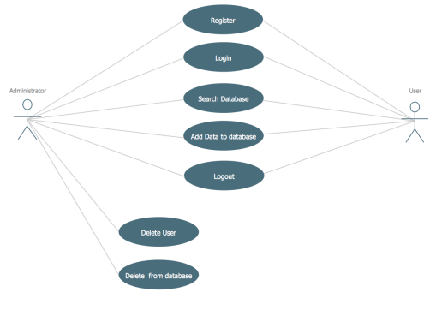
PROPOSED SYSTEM ARCHITECTURE

Slide 7
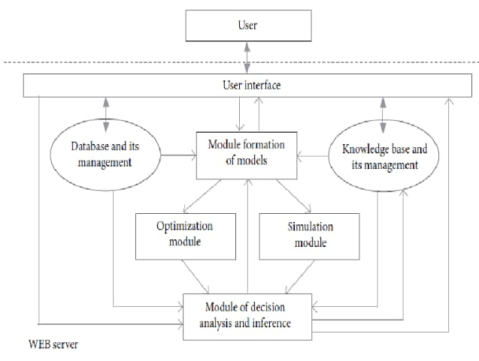
EXISTING SYSTEM ARCHITECTURE

Slide 8
SOFTWARE AND HARDWARE REQUIREMENTS
HARDWARE
SOFTWARE
Computer with a 1.1 GHz or faster processor
Minimum 2GB of RAM or more
2.5 GB of available hard-disk space
5400 RPM hard drive
1366 × 768 or higher-resolution display
DVD-ROM drive
Operating System: Windows 10
Google Chrome/Internet Explorer
XAMPP (Version-3.7)
Python main editor (user interface): PyCharm Community
Workspace editor: Sublime text 3

Slide 9
MODULES
User Authentication Module
Database Interaction Module
Product Management Module
Farmer Registration & Management Module
Admin Control & Management Module

Slide 10
SUMMARY OF MODULE-1 USER AUTHENTICATION MODULE
The User Authentication Module in the project ensures secure access to the application by validating users based on their credentials. This module is designed to handle user login, registration, and session management. It verifies user identities using authentication methods such as username and password. After successful login, users gain access to the system according to their roles (e.g., admin or user). This module also includes functionalities for password recovery and role-based access control, ensuring that only authorized users can access certain features of the system. It helps safeguard sensitive data and ensures proper management of user roles within the application.

Slide 11
SUMMARY OF MODULE-2 DATABASE INTERACTION MODULE
The Database Interaction Module facilitates the seamless exchange of data between the application and the underlying database. This module plays a critical role in managing data related to users, products, orders, and other essential entities in the system. By utilizing SQLAlchemy, it simplifies database operations such as creating, reading, updating, and deleting records. The module ensures that all user inputs, like registrations, product purchases, and order requests, are properly stored and maintained. Additionally, this module ensures efficient querying and retrieval of data, providing quick access to the necessary information for both the front-end user interface and the administrative backend.

Slide 12
SUMMARY OF MODULE-3 PRODUCT MANAGEMENT MODULE
The Product Management Module is responsible for managing all aspects of the products in the system, including adding, updating, and removing product listings. It allows administrators to define product details, such as name, description, price, quantity, and category. This module also facilitates the tracking of product availability, ensuring that users can view up-to-date information about the products they wish to purchase. For farmers, it simplifies the process of uploading their products for sale, managing inventory, and ensuring that only available products are listed for sale. The module also integrates with the database to store and retrieve product information efficiently.

Slide 13
SUMMARY OF MODULE-4 FARMER REGISTRATION & MANAGEMENT MODULE
The Farmer Registration and Management Module is designed to facilitate the registration and management of farmers within the system. It allows farmers to create and maintain their profiles, which include essential details such as name, contact information, farming type, location, and products for sale. Through this module, farmers can easily register, update, or delete their accounts as needed. Once registered, farmers gain access to various functionalities, such as adding and managing products for sale, tracking their sales and orders, and managing their profiles. This module is also responsible for verifying the information entered by farmers during registration to ensure that accurate and complete data is stored in the database.

Slide 14
SUMMARY OF MODULE-5 ADMIN CONTROL & MANAGEMENT MODULE
The Admin Control and Management Module is a vital component of the system, designed to allow administrators to effectively manage and oversee all aspects of the application. This module enables administrators to control user access, including the ability to add, update, or delete farmer profiles, as well as manage product listings, orders, and other platform functionalities. The admin can monitor all activities within the system, such as tracking orders, reviewing product statuses, and ensuring that the platform runs smoothly and securely.

Slide 15
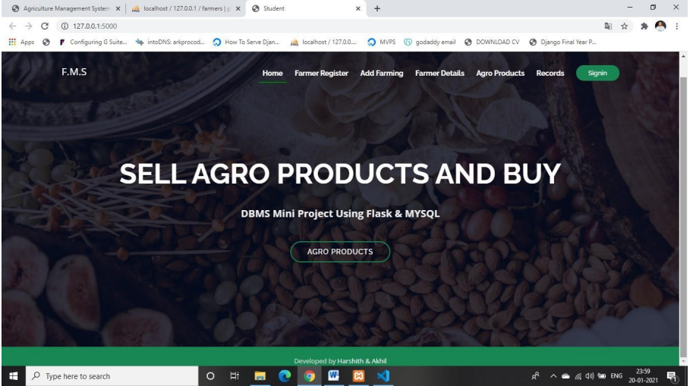
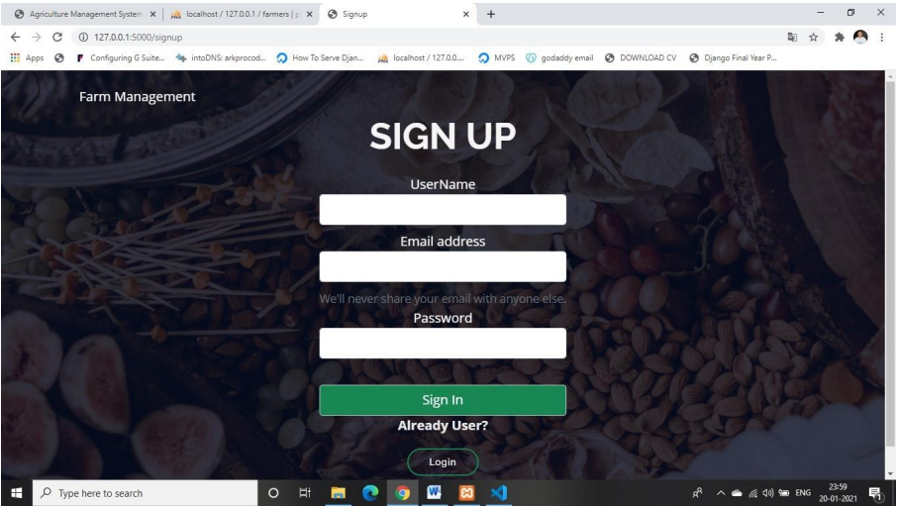
RESULTS AND DISCUSSION
HOME PAGE
SIGN UP PAGE

Slide 16
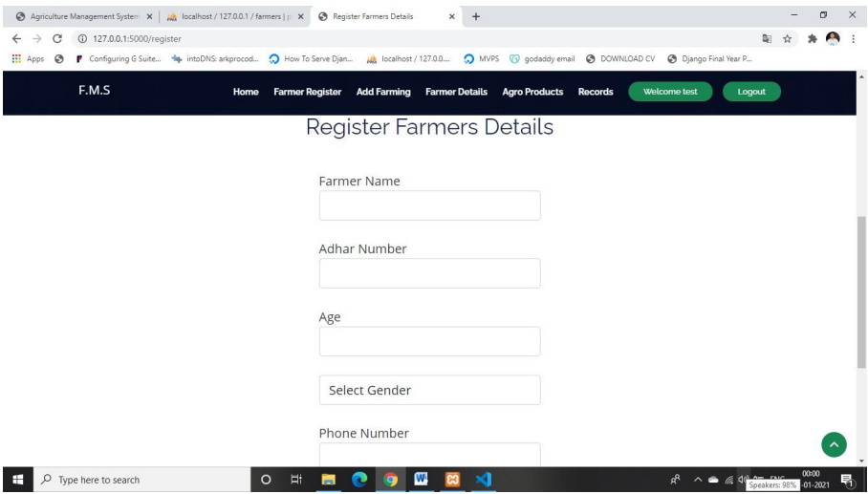
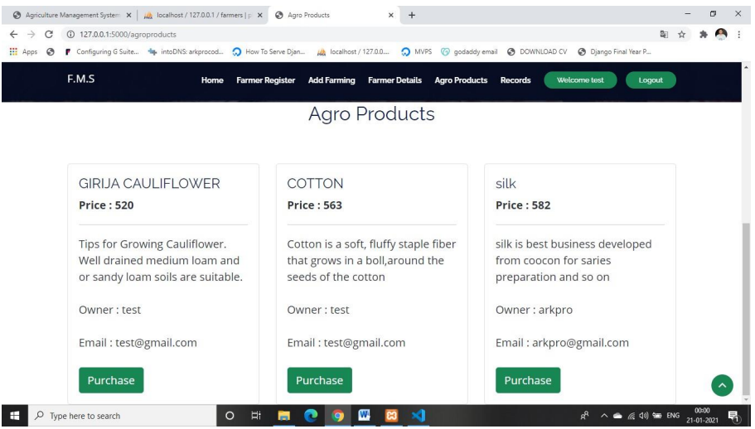
RESULTS AND DISCUSSION
REGISTRATION PAGE
PRODUCT VIEW PAGE

Slide 17
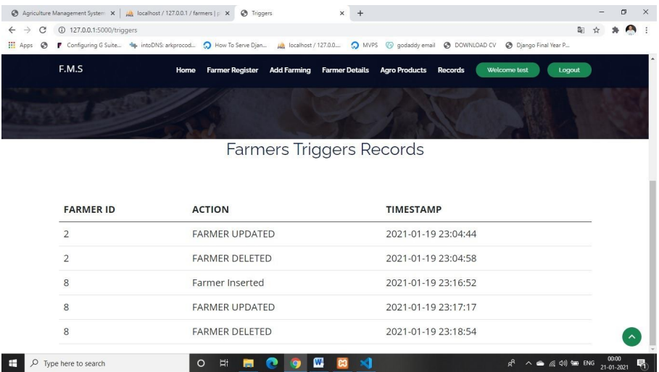
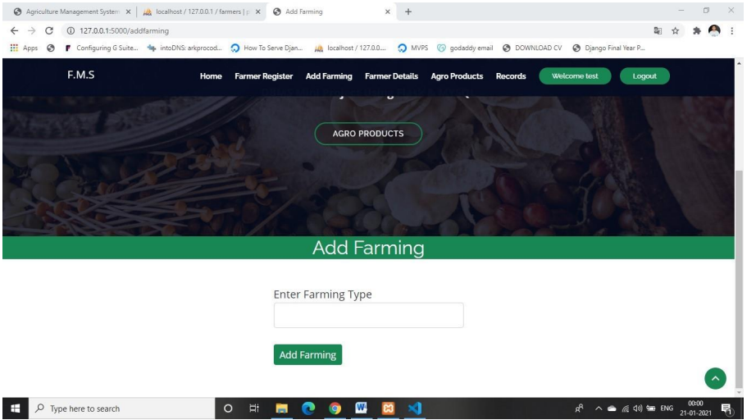
RESULTS AND DISCUSSION
TRIGGER RECORDS
FARMING TYPE

Slide 18
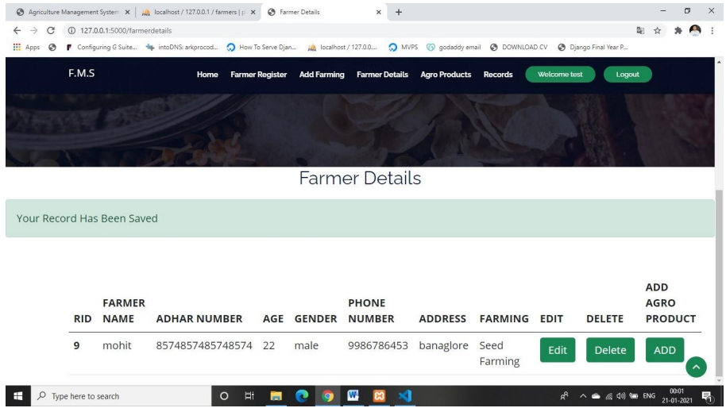
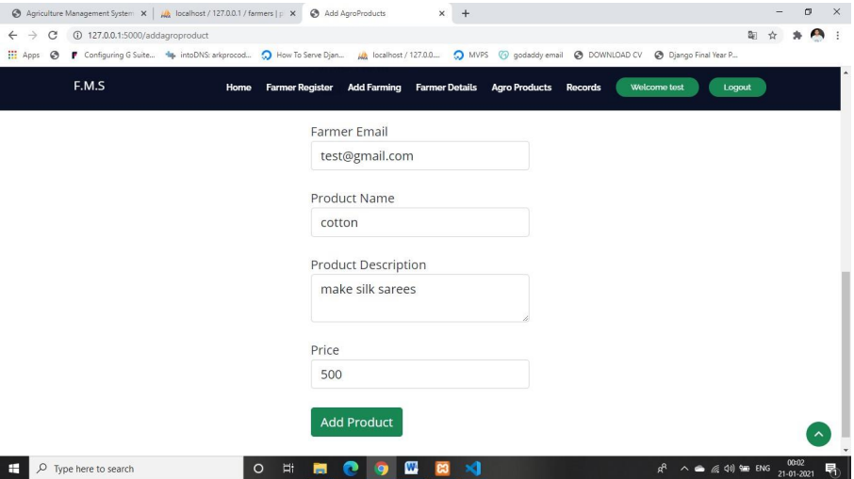
RESULTS AND DISCUSSION
FARMER DETAILS PAGE
ADD PRODUCT PAGE

Slide 19
CONCLUSION
The project successfully bridges the gap between farmers and buyers, promoting efficient trade and knowledge sharing, which contributes to improved agricultural practices and overall productivity.
By providing an intuitive interface and seamless functionalities for managing profiles, purchasing tools, and selling products, the system ensures ease of use and accessibility for all users.
The integration of quality-check requests and email communication fosters trust between buyers and sellers, ensuring the delivery of high-quality agricultural products.
Leveraging modern technologies such as Python Flask and SQLAlchemy, the system offers a secure, scalable, and future-ready platform tailored to the evolving needs of the agricultural community.

Slide 20
THANK YOU

